Slide 1
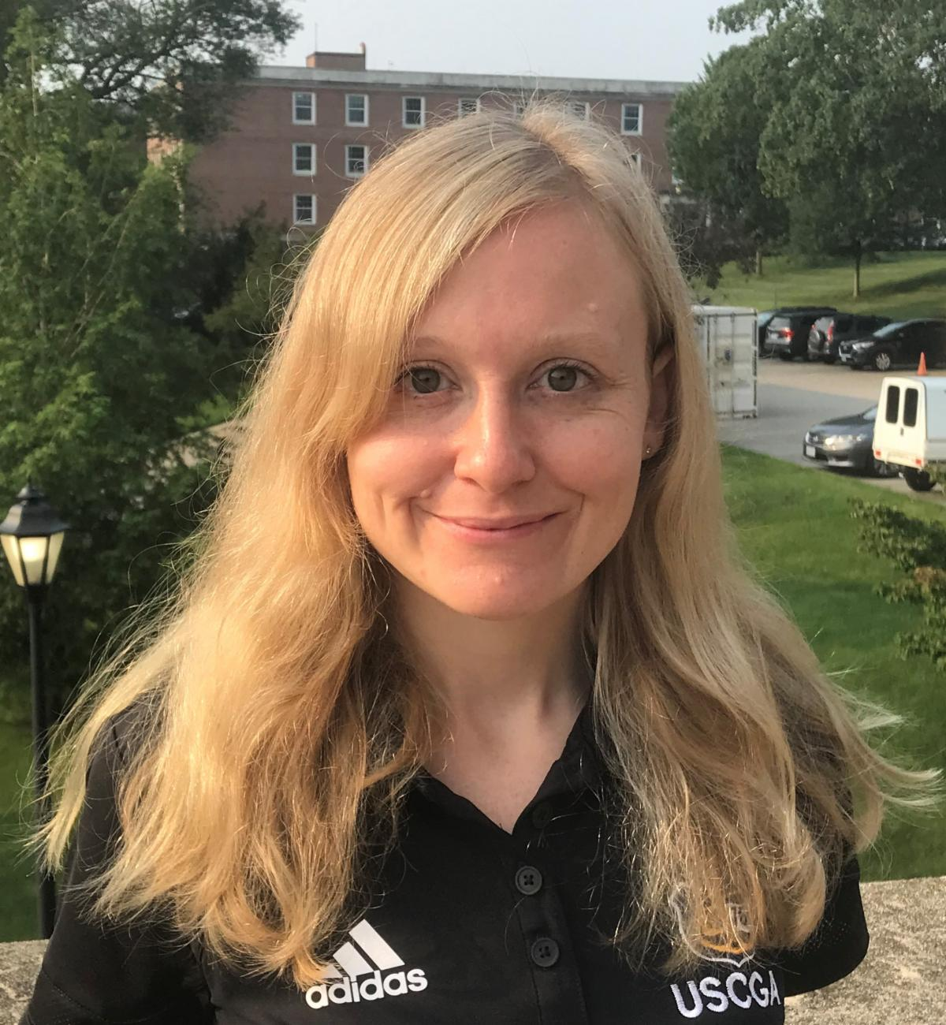
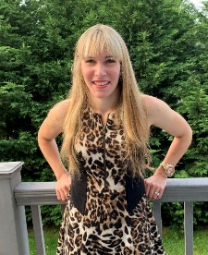
USCGA Admissions Partner Overview
Associate Director for Volunteer Programs
Vacant
Associate Director for Diversity Outreach
& Student Engagement
Katy Robbins
Katy.A.Robbins@uscga.edu l 860.701.6177
Volunteer Programs Support & Marketing Specialist
Stefanie Senkow
Stefanie.J.Senkow@uscga.edu l 860.701.6327

Slide 2
AAP History
1930's: The Auxiliary Academy Information Program (AIP) formed as the first volunteer workforce for the Coast Guard Academy Admissions office. It was primarily responsible for the Academy Introduction Mission (AIM). Throughout its existence, this program evolved to meet the needs of the Coast Guard Academy. In 2006 it became the Coast Guard Academy Admissions Partner (AAP) program.
Notes:
CGATE, AIP

Slide 3
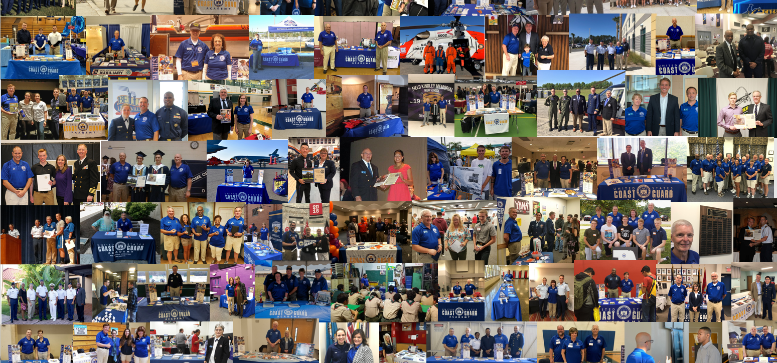

Slide 4
START: Identify & Recruit Volunteers
Train
Communicate Expectations
Coordinate Activity
Provide Recognition
Collect Feedback
USCGA admissions partner cycle

Slide 5
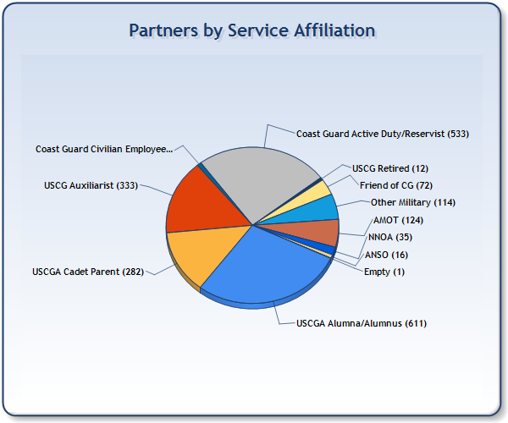
Partner make up
Currently 1,306 AAPs
28% female, 16% Underrepresented Minorities
47% Alumni, 41% Active Duty/ Reserve, 26% Auxiliary, 22% Parents!
64 State & Regional Coordinators
2 Interview Coordinators, 1 Auxiliary Liaison + Regional Leads
Academy Minority Outreach Team (AMOT)
126 Members
Management & Advisory Board

Slide 6
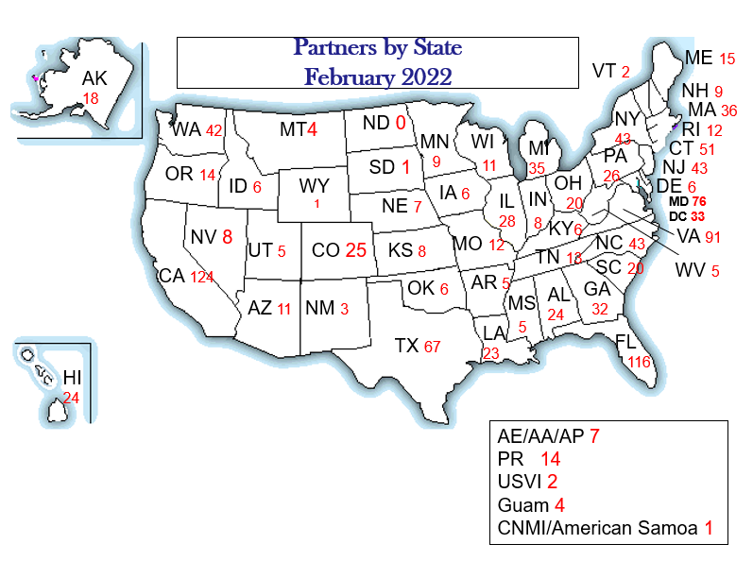

Slide 7
What we do: Outreach vs recruiting
Outreach: Awareness & Education
Service Culture
Quality of life
Ask/Answer Questions
Call to action
Recruiting: Building Relationships

Slide 8
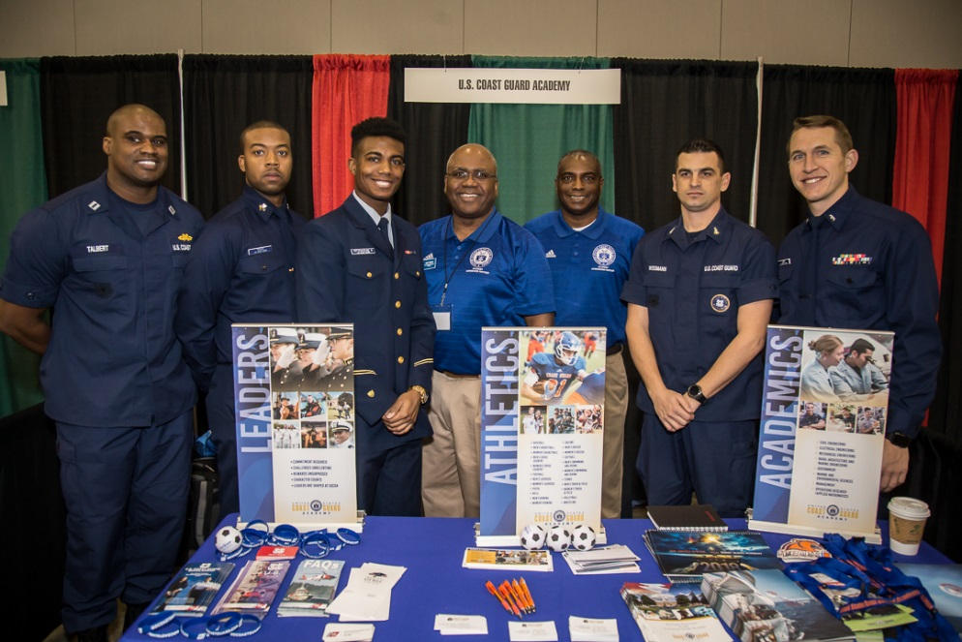
Get Involved
You are a messenger –
Spread the good word!
High School Visits
College Fairs
CGA Representation at AUX/CG Events
Congressional Service Academy Events
Interviews
Appointment Presentations
Admissions Workshops
EAGLE Events
Academy Introduction Mission (AIM)

Slide 9
Support | 2021-2022 | 2020-2021 | 2019-2020 | 2018-2019 | 2017-2018 | 2016-2017 | 2015-2016
College Fairs | 133 | 88 | 392 | 402 | 389 | 397 | 347
Applicant Interviews | 373 | 1,218 | 632 | 598 | 373 | 323 | 369
HS Visits | 272 | 162 | 222 | 303 | 272 | 252 | 107
Congressional Events | 157 | 50 | 199 | 224 | 157 | 79 | 158
Other (personal outreach, Admissions event, JROTC, Congressional office visit) | 145 | 205 | 399 | 230 | 145 | 156 | 302
Appointment Presentations | 51 | 25 | *COVID | 36 | 51 | 30 | 77
Total AAP Events | 1387 | 1,748 | 1,837 | 2,034 | 1,387 | 1,237 | 1,360
Activity by Year

Slide 10
Partner Activity Totals 2021
 | Miles | Event Length (Hrs) | Number of Students At Event | Percent Minorities | Percent Female | Quality Interactions
Nov-Dec | 7866 | 501 | 18686 | 28% | 29% | 1593
Sep-Oct | 11686 | 677 | 38893 | 27% | 34% | 3038
Jul-Aug | 9113 | 301 | 1187 | 19% | 24% | 455
May-Jun | 2685 | 208 | 4056 | 26% | 34% | 502
Mar-Apr | 481 | 109 | 1153 | 20% | 19% | 406
Jan-Feb | 340 | 270 | 619 | 23% | 23% | 282
Total | 32,171.00 | 2,066.00 | 64,594.00 | 24% | 27% | 4683
 | Dollars saved | $ 45,452.00 | $22/service hour: CG value for one hour of Auxiliary volunteer support

Slide 11
Academy minority outreach team (AMOT)
AMOT Mentor Program Administrator
Ms. Katy Robbins, Associate Director of Diversity, Outreach and Student Engagement Katy.A.Robbins@uscga.edu
AMOT Segment Coordinators
African American: CDR Andrea Parker-Smith Andrea.JP.Smith@uscg.mill
Asian American: CDR Min Kim Min.H.Kim@uscg.mil
Hispanic American: CDR David Smith Daivd.ASmith@uscg.mil

Slide 12
AMOT Support
Targeted Outreach Efforts
Parterning with Community Based Organizations to help develop future applicant pools
Participate in Yeilding Campaigns
Leverage Mentorship

Slide 13
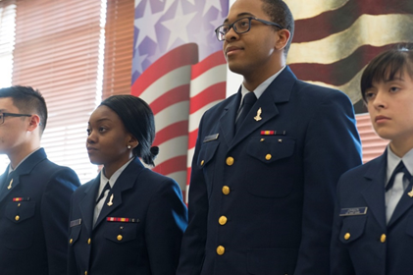
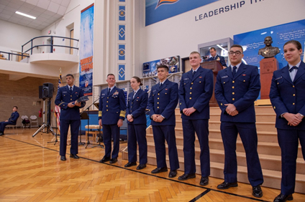
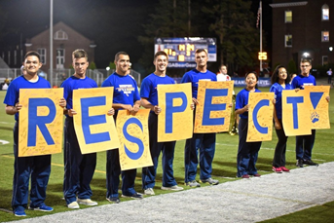
Chronus: AMOT Mentoring
What is it: facilitates one-to-one mentoring relationships that connect current minority cadets and minority appointees with leaders in the Coast Guard to learn, grown, and develop.
Mentor's Role: Our deep and experienced pool of AMOT mentors volunteer to share their educational, career, and life experiences with mentees to support expanding social networks, fine tuning leadership capabilities, and foster personal and professional development.
Get Involved: Academy Minority Outreach Team | Program Overview (chronus.com)

Slide 14
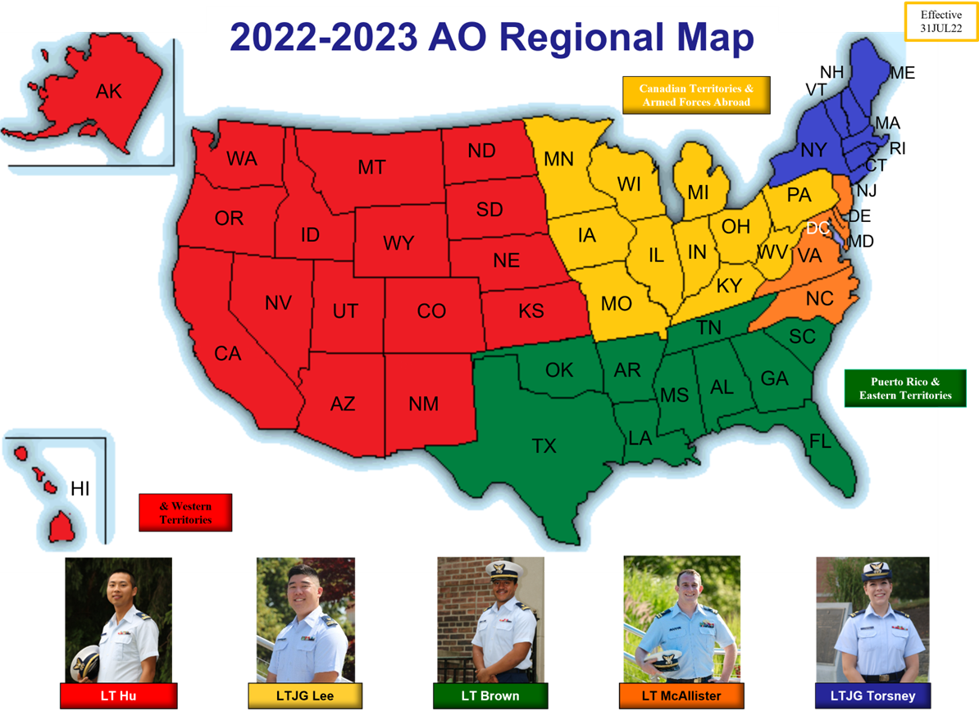
USCG Academy Admissions Officers

Slide 15
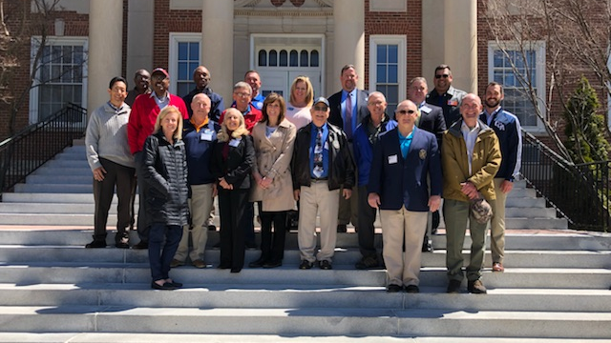
Resources
AAP Training
Website Resources:
www.uscga.edu
www.uscga.edu/partners
www.uscgasports.com
www.gocoastguard.com
Bears Den: “Partner Documents”
LinkedIn Group: U.S. Coast Guard Academy Admissions Partners
YouTube Training Videos

Slide 16
Questions?

